Slide 1

Predicting Realty Prices
in Russian Housing Market
Team Jade
Bo Lian, Jade Le-Cascarino, Daniel Rim, Choutine Zhou

Slide 2
Approach
Kaggle Competition : Sberbank Russian Housing Market
Phase 1 Data Exploration
Phase 2 Feature Selection
Phase 3 Modeling

Slide 3
Results
Kaggle Ranking: 50% at 0.324
Comments:

Slide 4
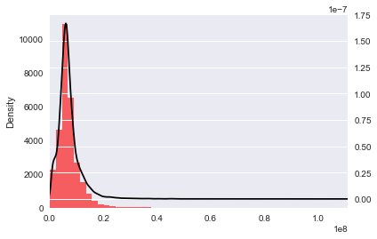
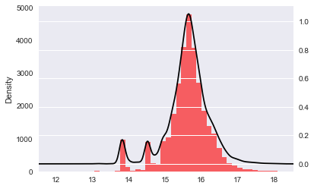
Price log transformation

Slide 5
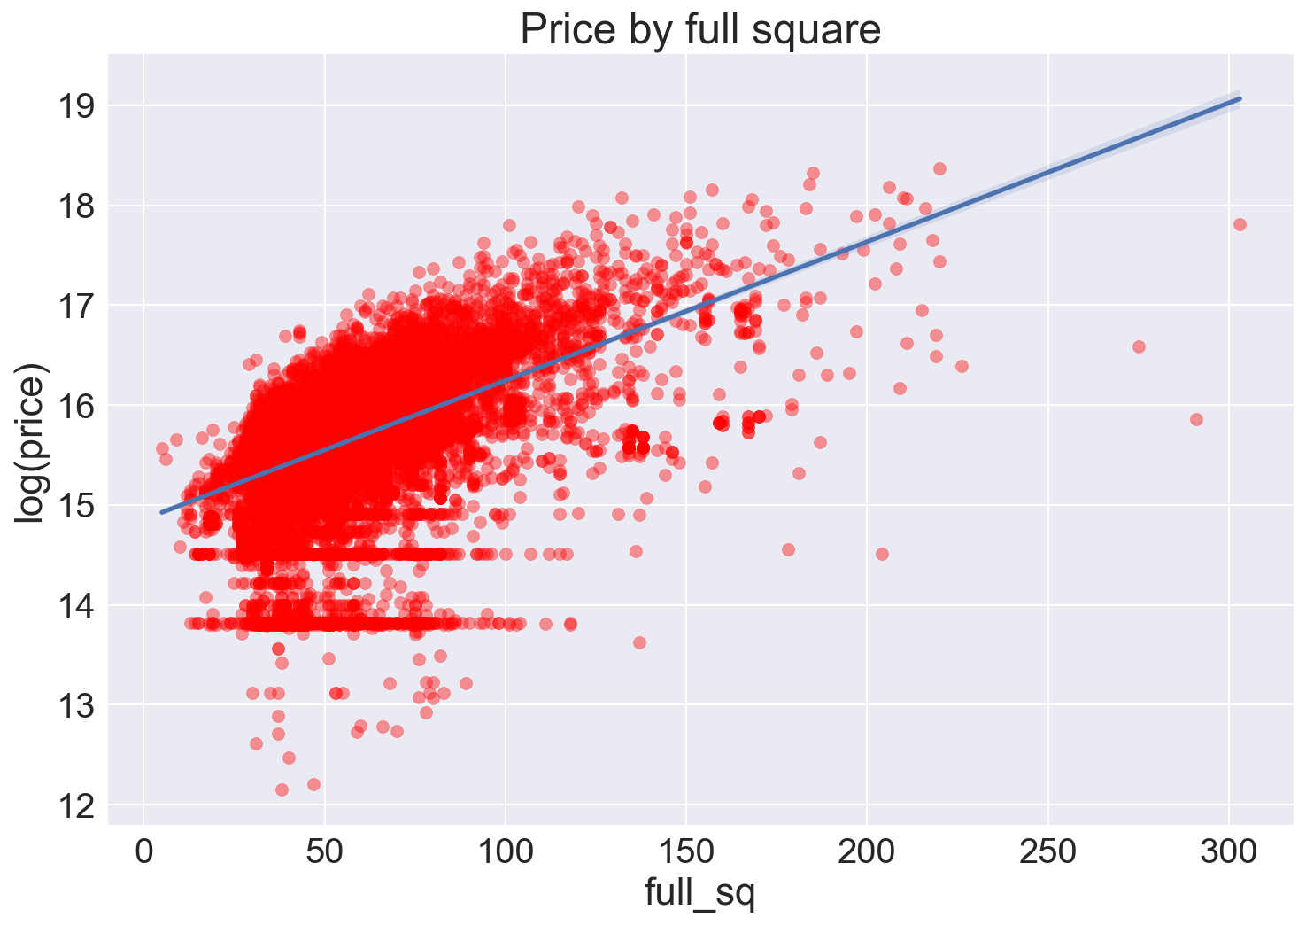
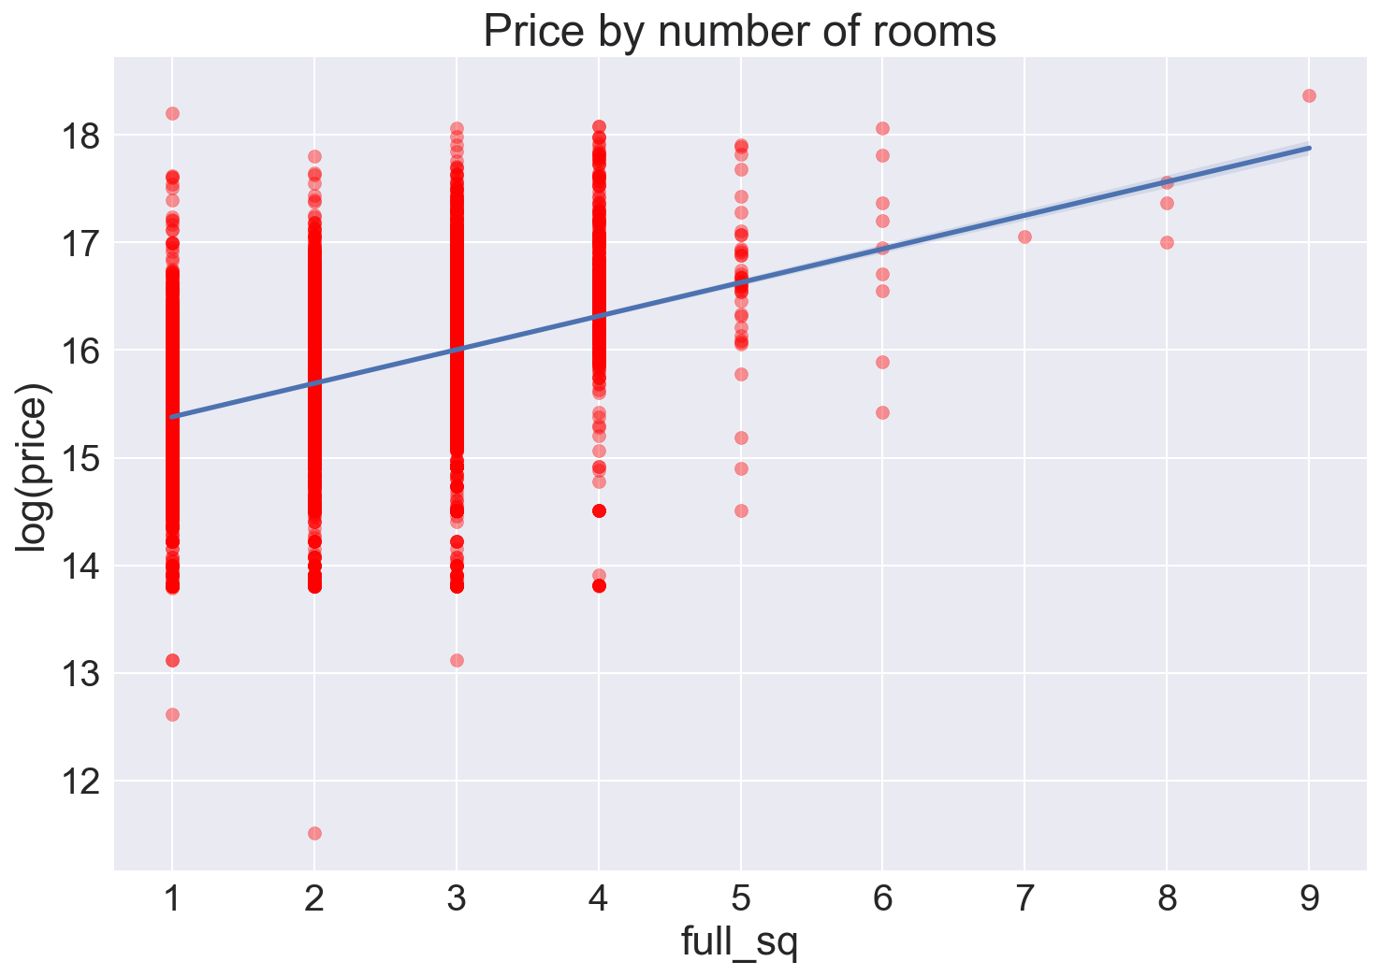
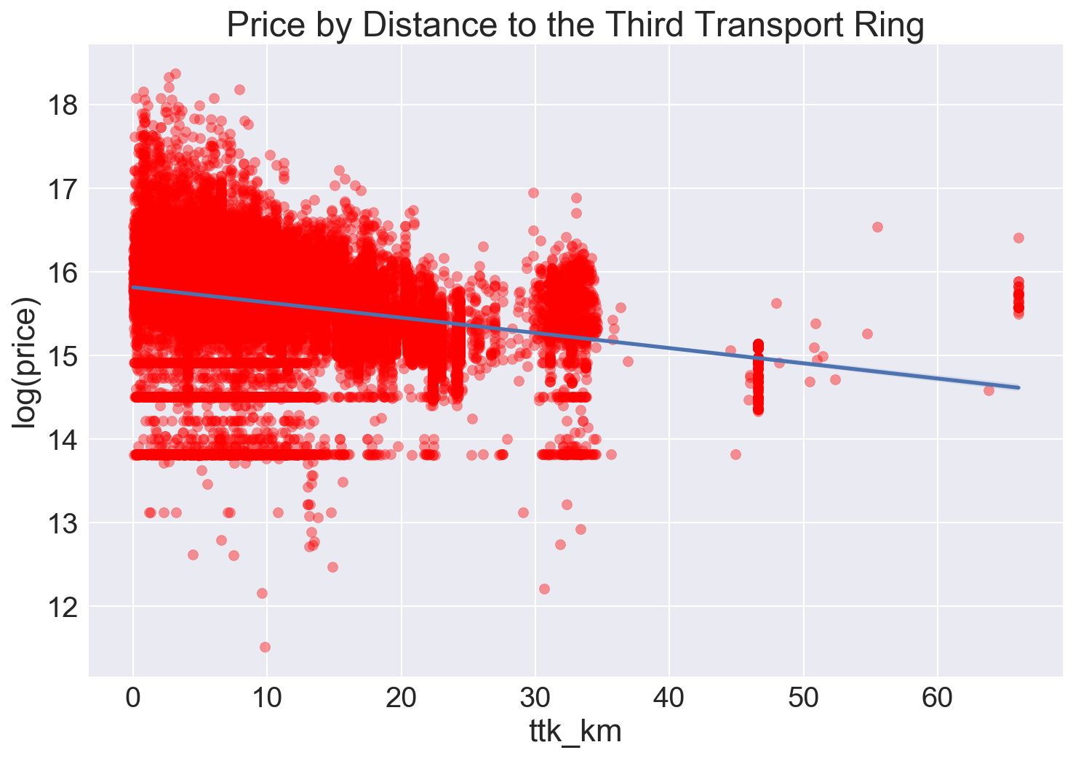
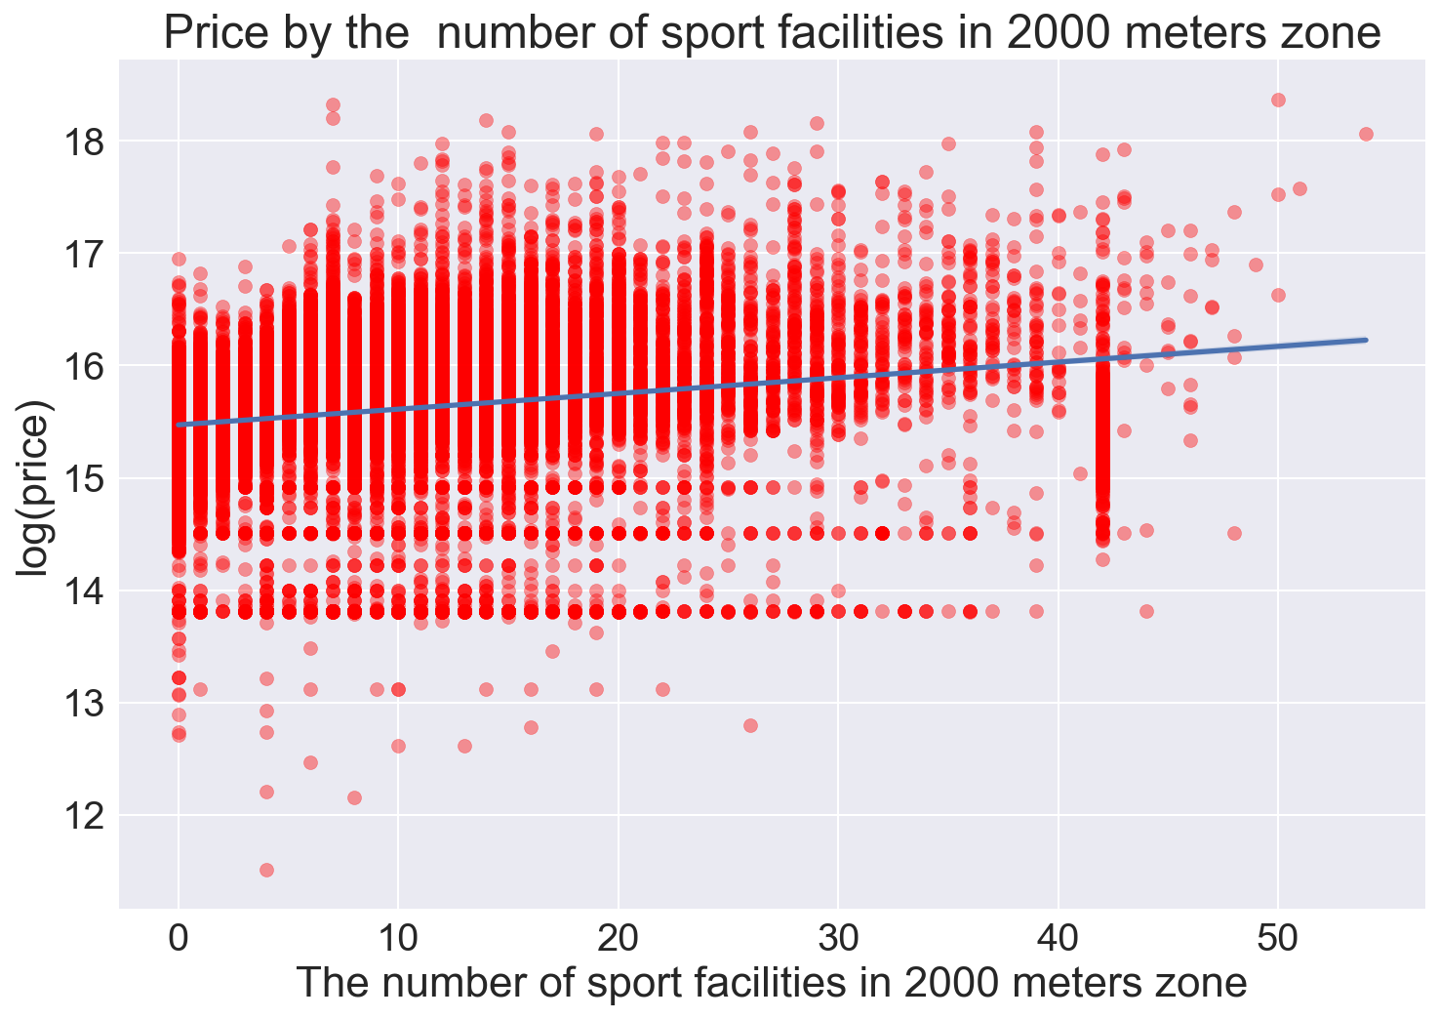
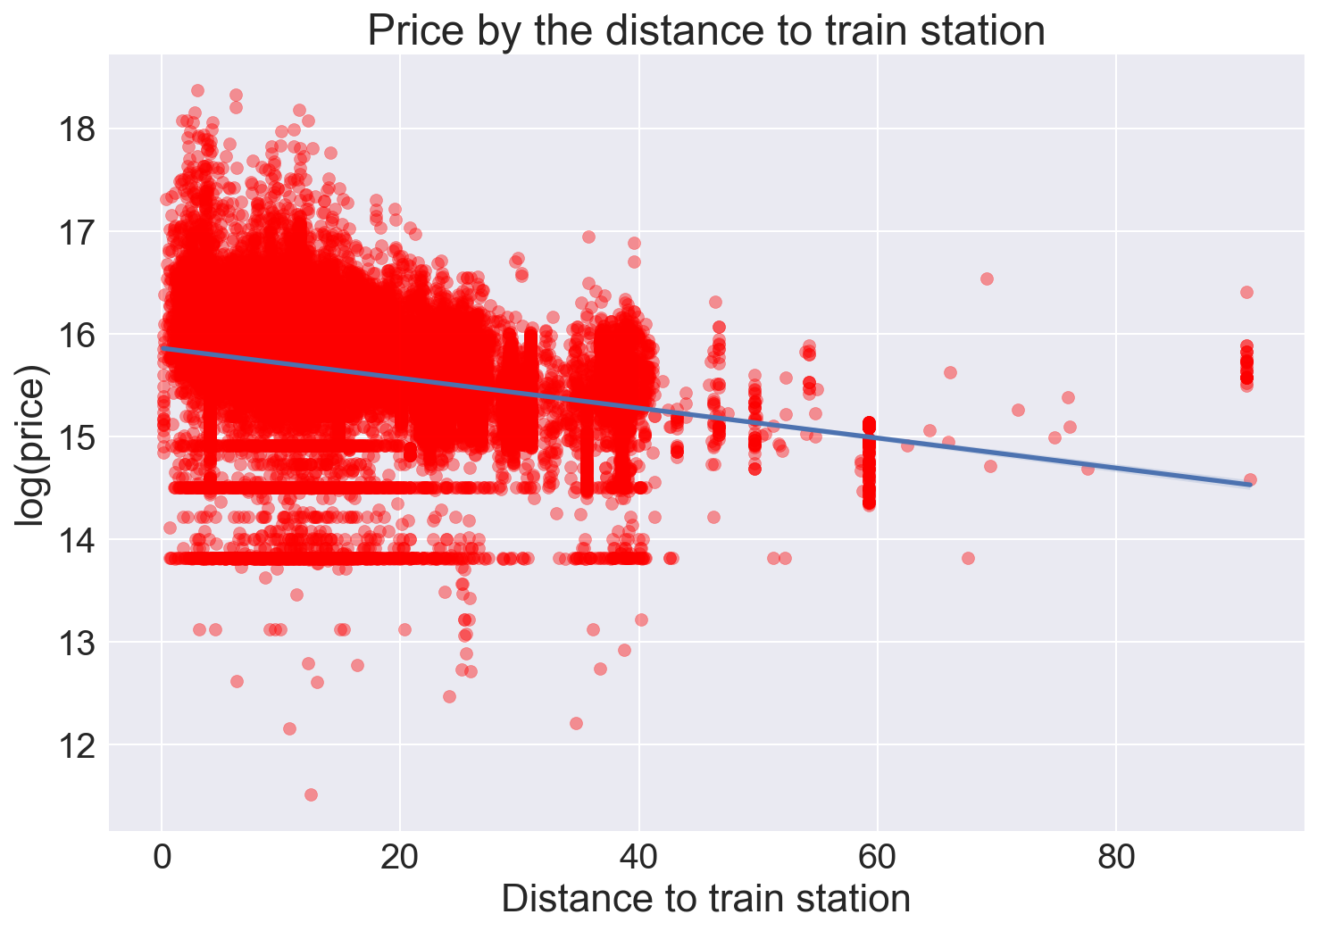
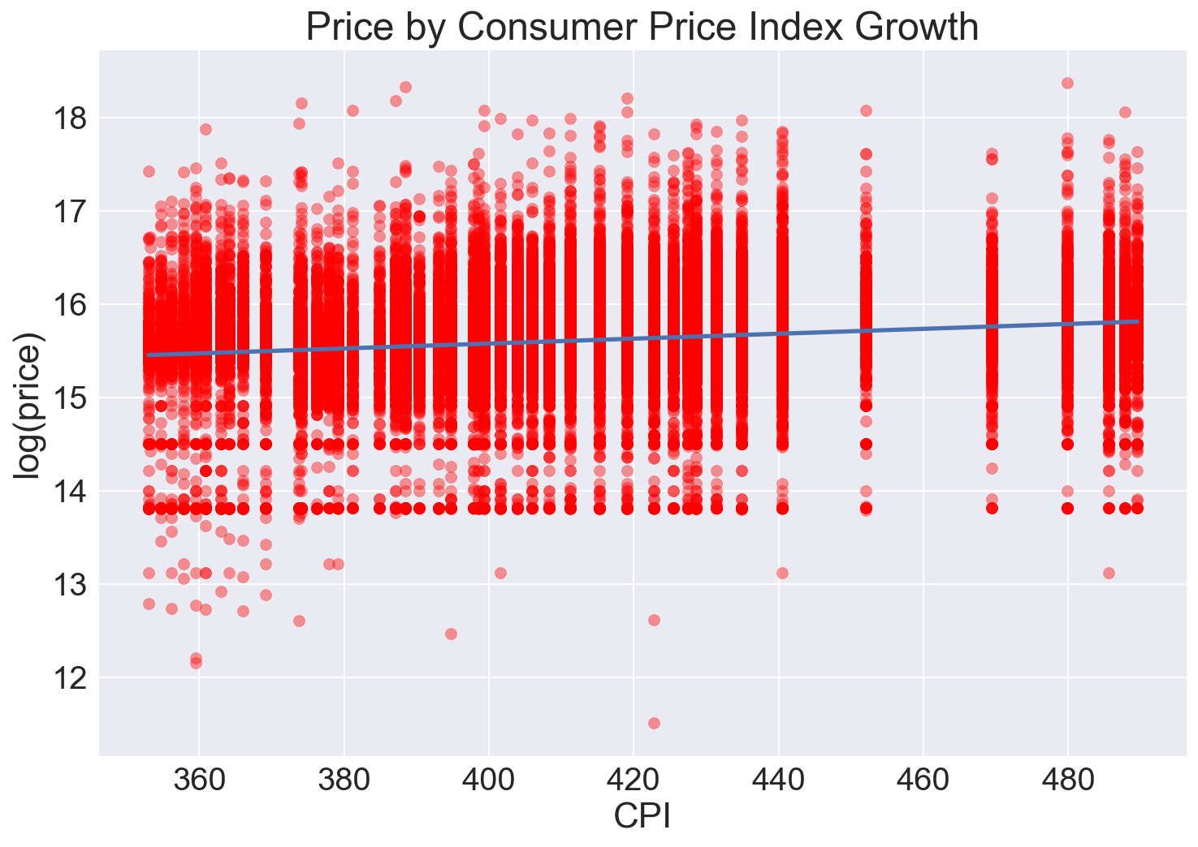
Major predictors used accross models

Slide 6
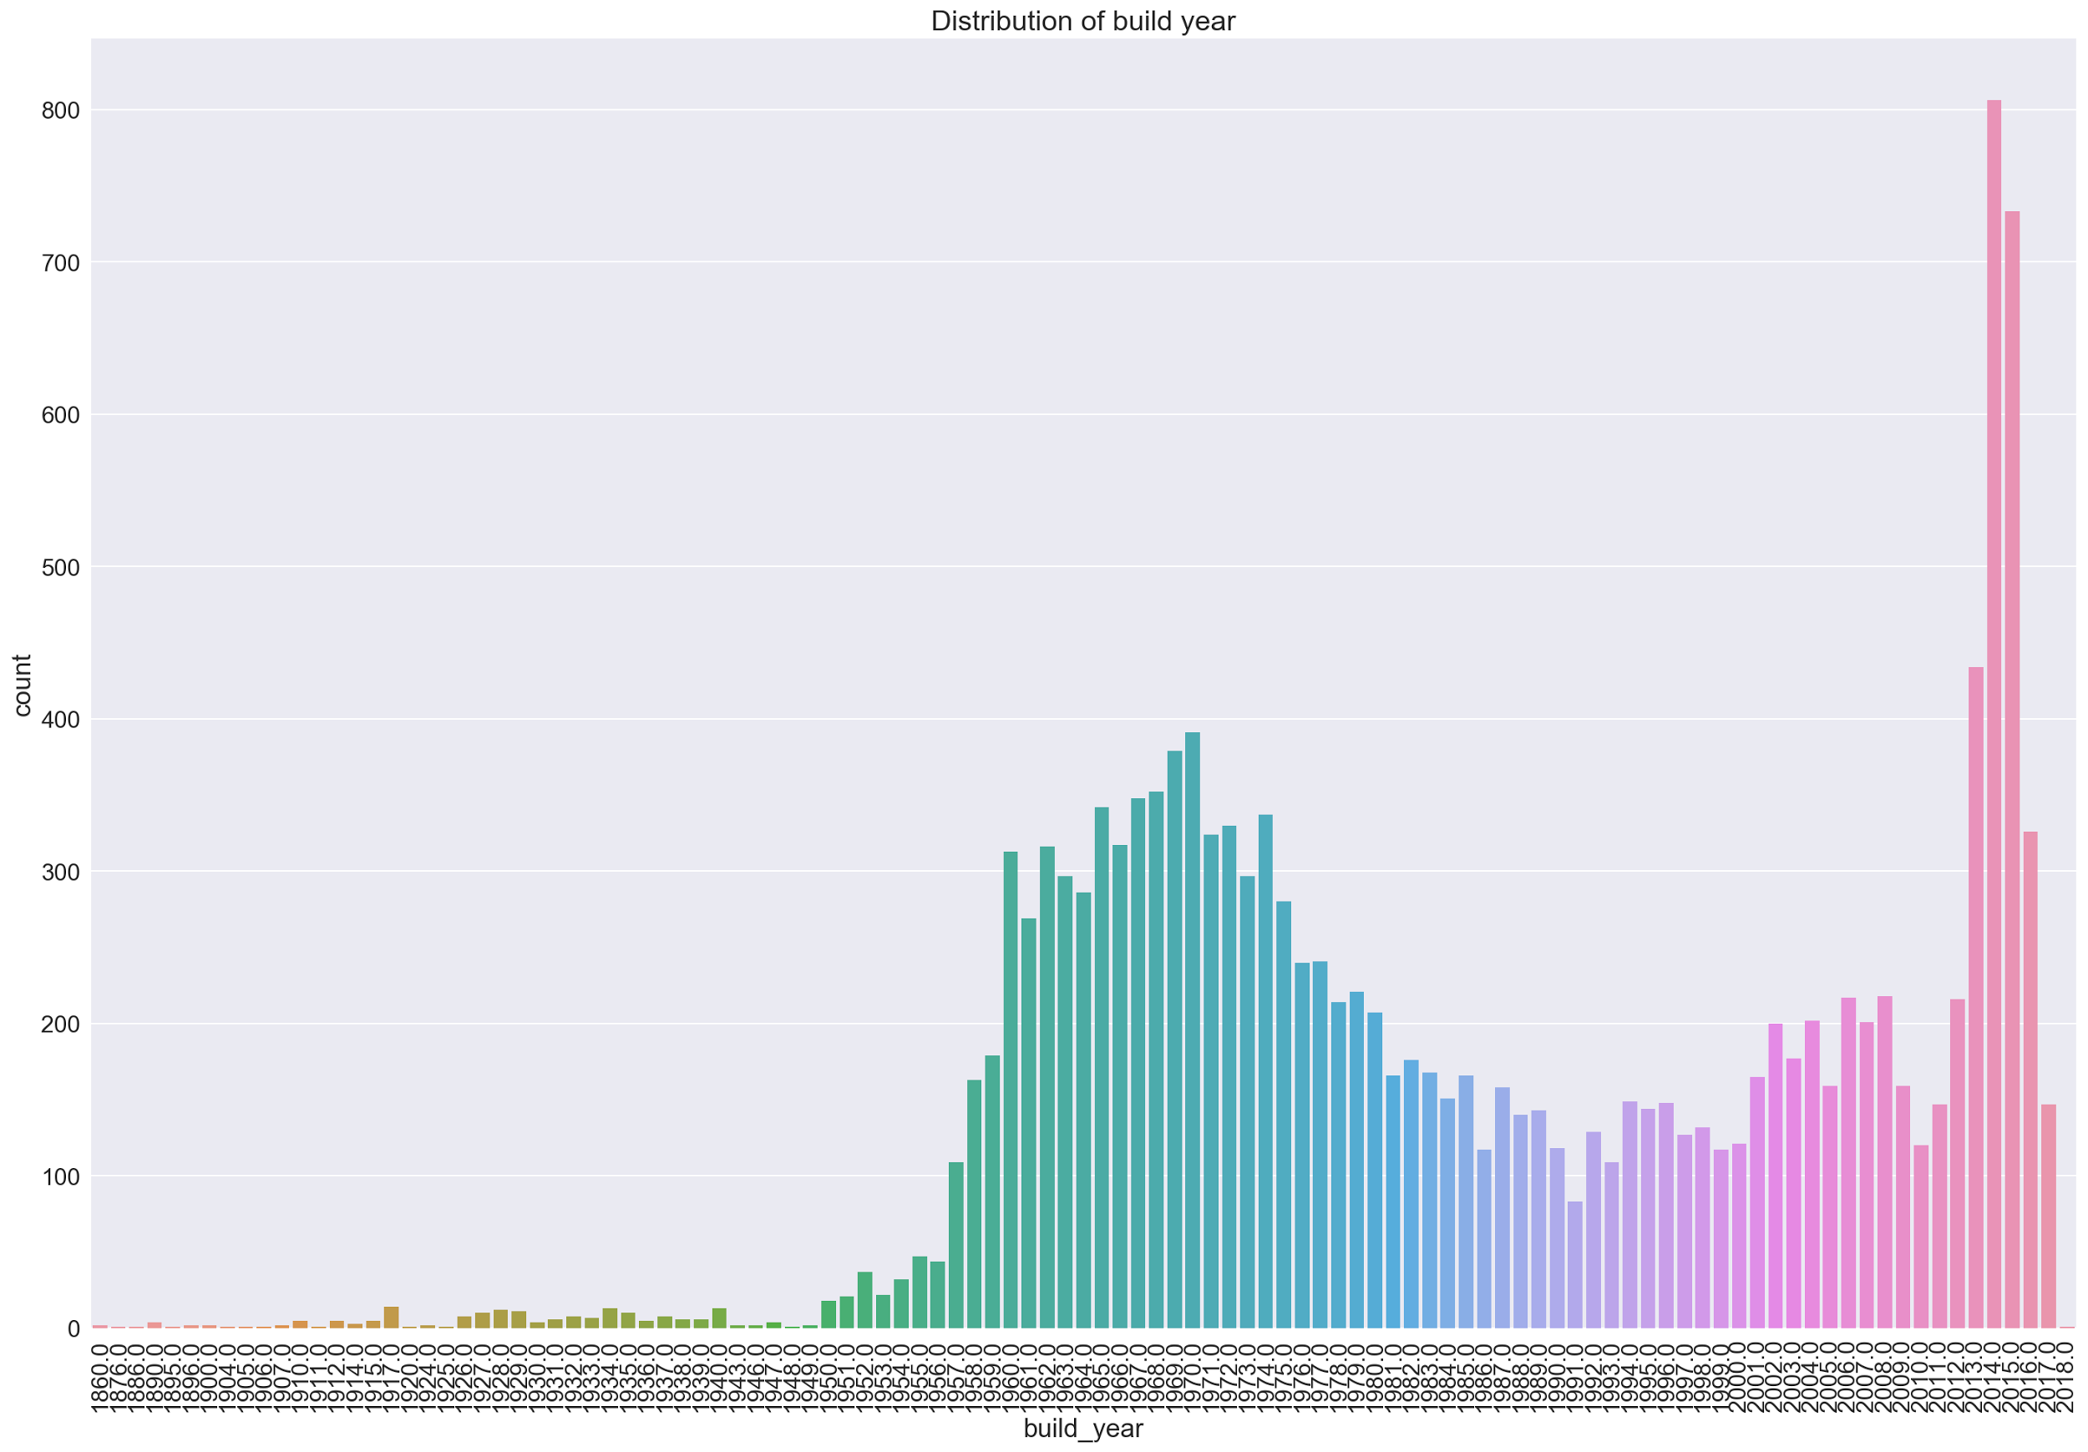
Distribution of build year

Slide 7
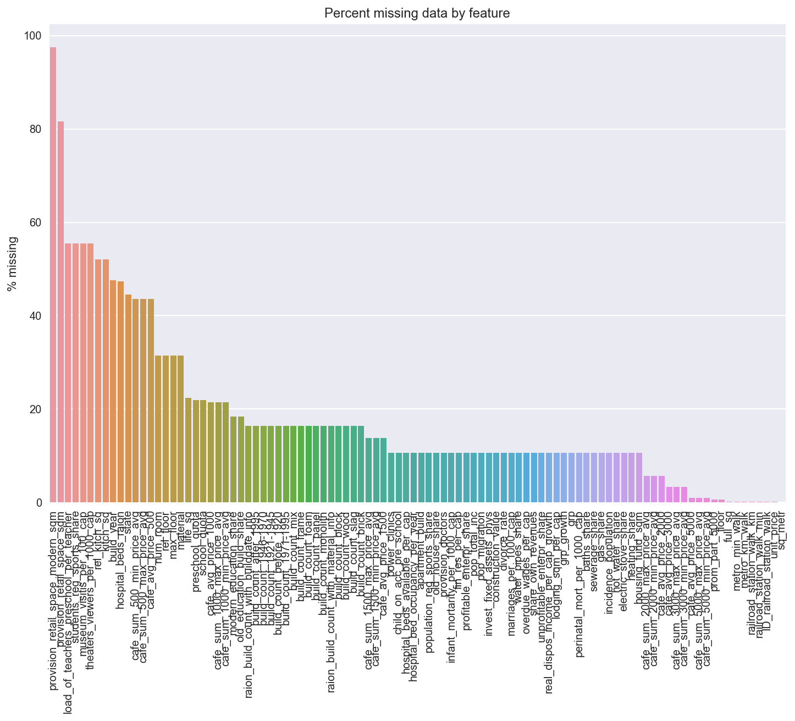

Slide 8
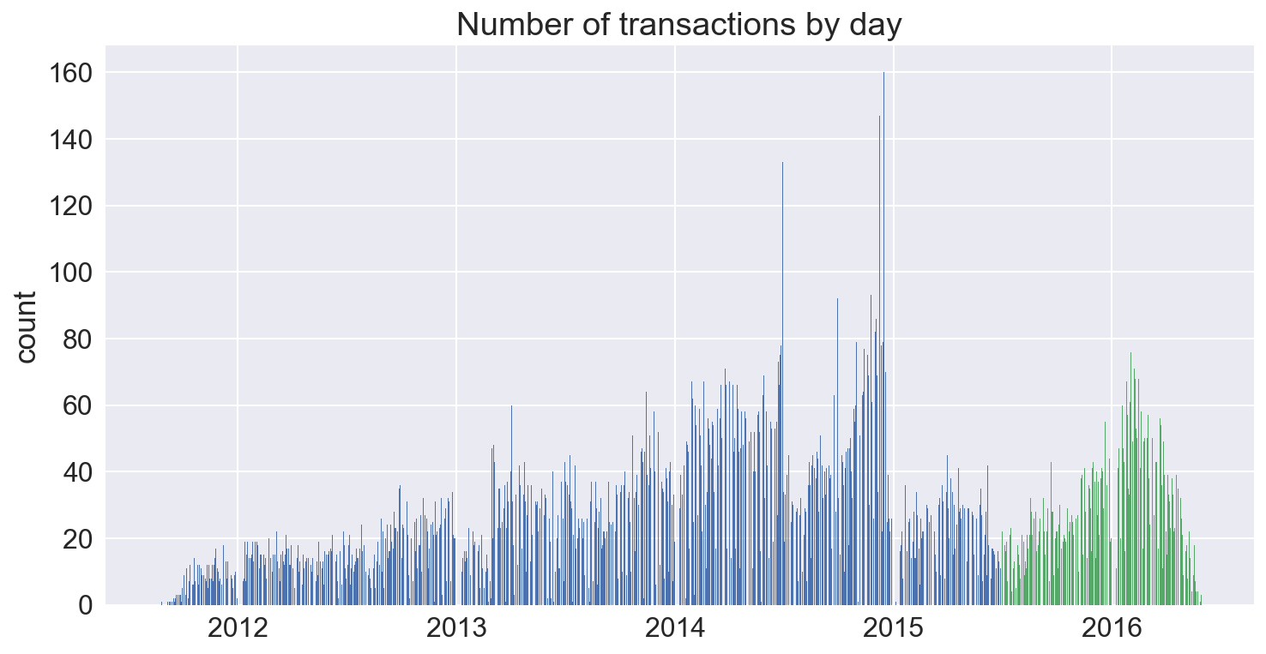

Slide 9
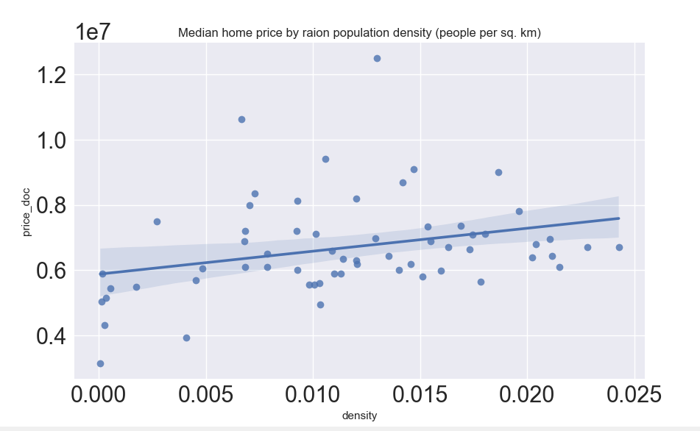
Price by Density

Slide 10
Feature Selection with Random Forest & Lasso
292 features
Step 1: Divide features into subgroups (i.e. demographics) => 16 subgroups
Step 2: Run random forests and Lasso on each subgroup
Results: In most groups, LASSO would provide that all the features in the group are significant at the minimum MSE level for lambda parameter
In order to select features, we have chosen parameters that would go to zero slowest as lambda increases
35 features came out to be ideal in this case with MSE of 0.31 or RMSE of 0.56 for training data set and 0.46 on Kaggle’s testing set score 0.35
Sub
group
Sub
group
Sub
group
Lasso
Random Forest
XGBoost
Selected Features

Slide 11
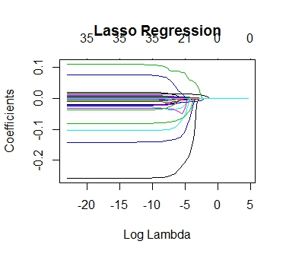
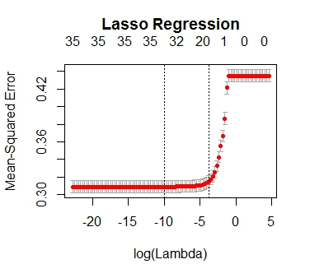
LASSO result

Slide 12
Multiple Linear Regression
We have also tried utilizing Multiple Linear Regression using select features that would make sense in making housing price prediction
For the simplest model, we have used ‘full_sq’(size of the unit), ‘ttk_km’(distance to the Third Ring), and ‘public_transport_station_min_walk’(minutes to walk to public transportation station)
Result was that this simple model gave a superior result to LASSO model with 35 features with RMSE of 0.499 on training set and Kaggle’s score of 0.37535
Using 15 features, we were able to lower RMSE a bit further to 0.466 on training set and Kaggle’s score of 0.35189
Macro data may not be as helpful as it is time series data and if year/month are included as independent variable, it would incorporate the time element

Slide 13
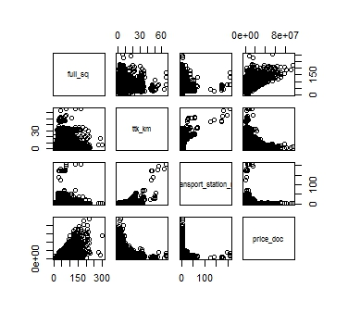
Scatterplot of 3 variables
From the Scatterplot it seems that housing price has positive relations with full_sq, and negative relationship with ttk_km and public_transport_station_min_walk
That is, the bigger the house/apartment, price is larger, closer to the third ring, it is more expensive, and closer to public transportation station, the price is higher

Slide 14
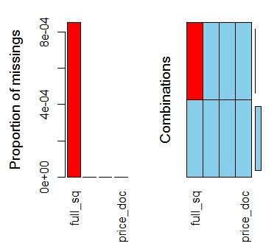
Missing Value Inspection
There are hardly any missing values for these features

Slide 15
Multiple Linear Regression Result(3 features)
RMSE for training set: 0.499
Estimate Std. Error
(Intercept) 15.0521835 0.0086749
full_sq 0.0145636 0.0001356
ttk_km -0.0194311 0.0004101
public_transport_station_min_walk -0.0016595 0.0002162
t value Pr(>|t|)
(Intercept) 1735.136 < 2e-16 ***
full_sq 107.432 < 2e-16 ***
ttk_km -47.385 < 2e-16 ***
public_transport_station_min_walk -7.674 1.71e-14 ***
Residual standard error: 0.499 on 30440 degrees of freedom
(26 observations deleted due to missingness)
Multiple R-squared: 0.3182, Adjusted R-squared: 0.3181
F-statistic: 4735 on 3 and 30440 DF, p-value: < 2.2e-16

Slide 16
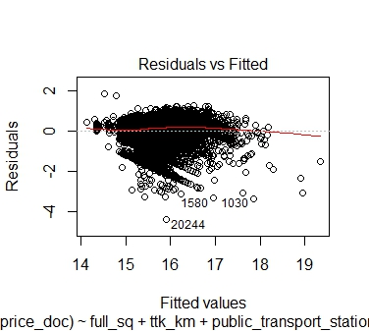
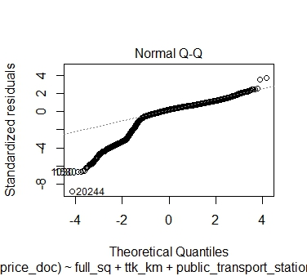
Multiple Linear Regression Assumption Charts

Slide 17
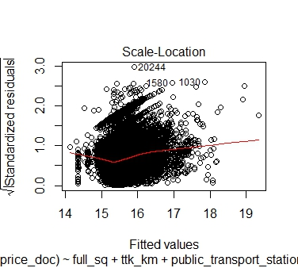
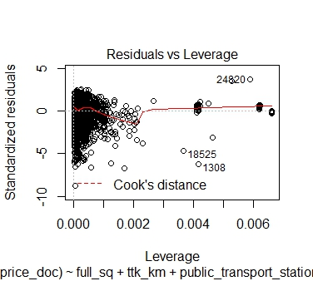
Multiple Linear Regression Assumption Charts

Slide 18
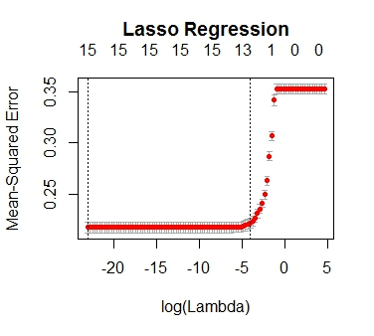
Multiple Linear Regression (15 features)
This version uses more features that would make sense in predicting housing prices(material feature has about 30% of the data missing and those observations were excluded)
LASSO would indicate that this model is not overfitted

Slide 19
XGBoost
An implementation of gradient boosted decision trees designed for speed and performance
Uses a gradient descent algorithm to minimize the loss
Why Use XGBoost?
Execution Speed
Accepts sparse feature format
Insensitive to collinearity
Model Performance

Slide 20
XGBoost
Features Selection: 11 main features + 28 other features +macro features
Other features
based on Feature Importance from LASSO, Random Forest and XGBoost
Macros: CPI, PPI,gdp_deflator
Notes:
17 Sub-Groups
Population, Public,Transportation,Facilities by Raion, Types_of_Building,Shopping Malls, Park and Center etc.

Slide 21
Feature engineering
Density = Raion_popul /area_m
month_year =month +year * 100
week_year =weekofyear + year * 100
df['dow'] = df.date.dt.dayofweek (Using datetime library)
rel_floor= floor /'max_floor
rel_kitch_sq = kitch_sq / full_sq

Slide 22
XGBoost Parameters (?)
Learning Rate : 'eta': 0.02
Depth of a Tree: 'max_depth': 5
Subsample Ratio of Training: 'subsample': 0.8
Subsample Ratio of Columns: 'colsample_bytree': 0.7
Learning Method: 'objective': 'reg:linear'

Slide 23
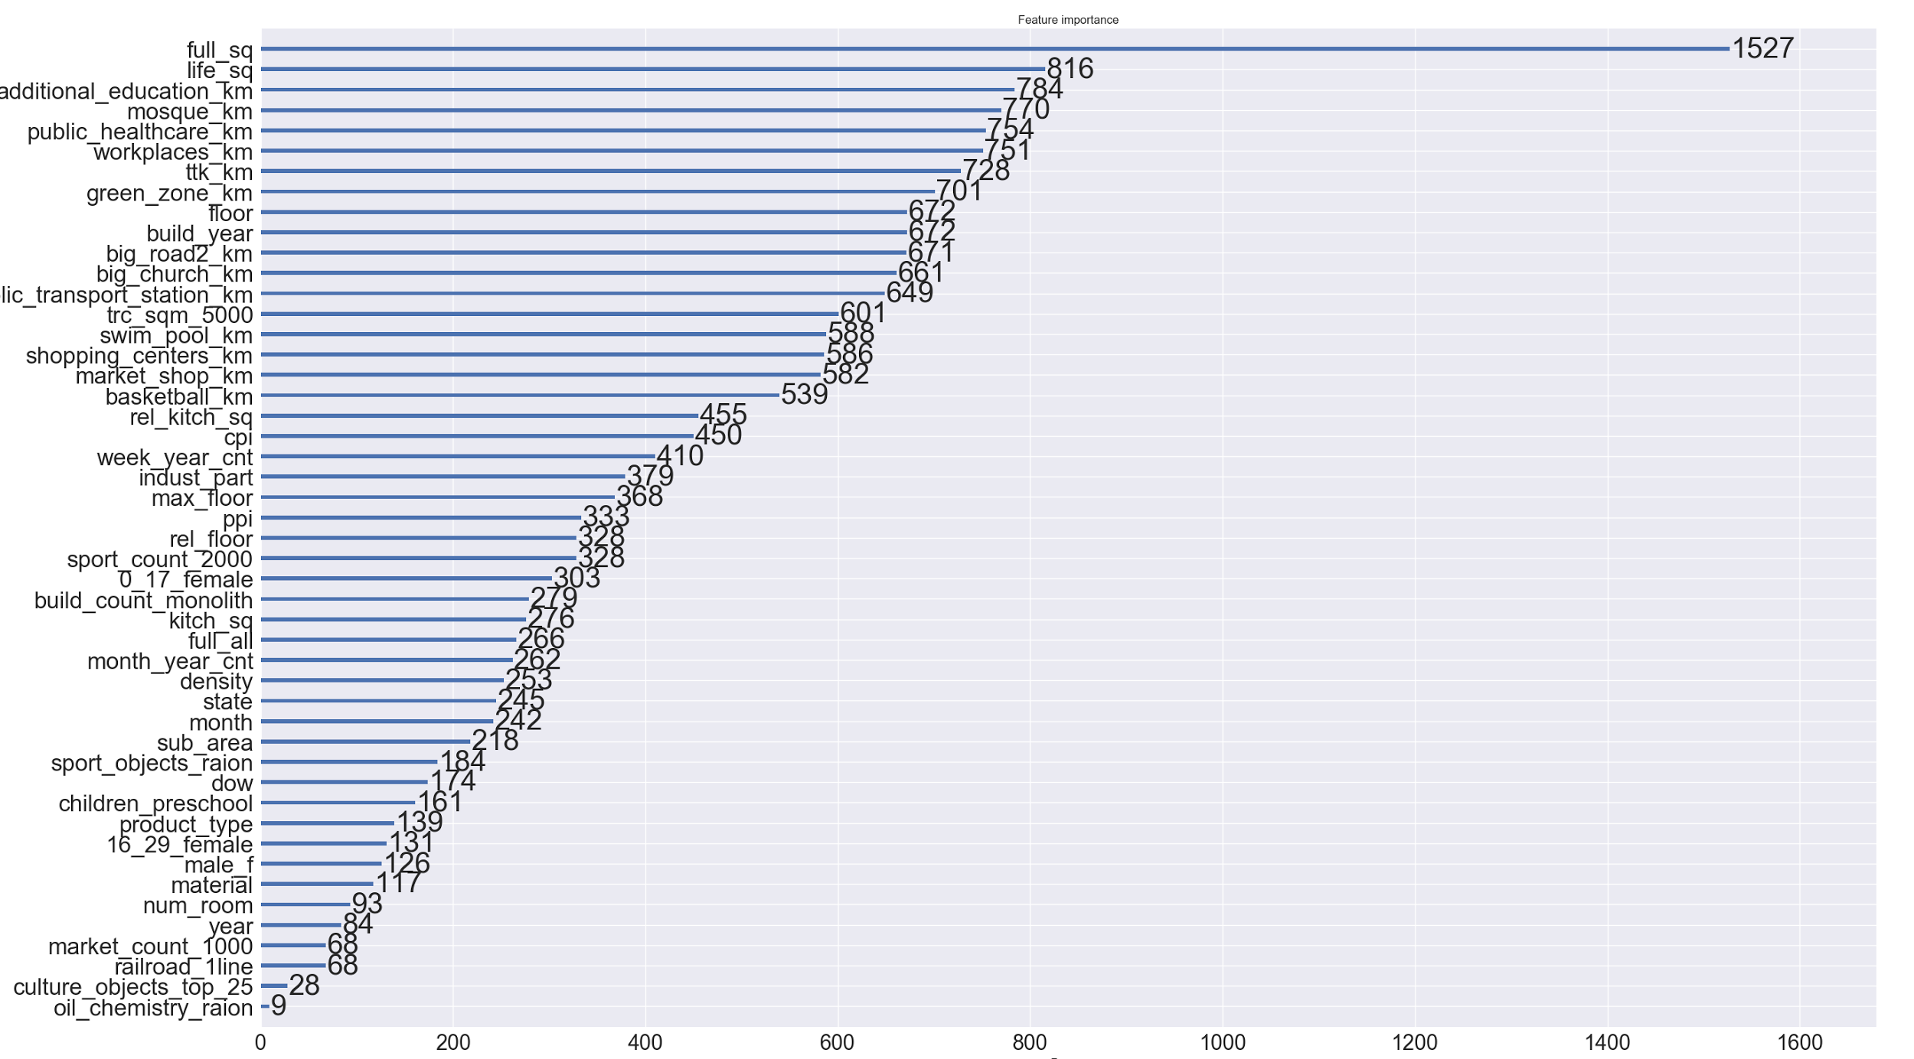
Feature Importance

Slide 24
Summary of Results
 |  | XGboost |  |  | Multiple Linear Regression
Features (n) | 6 | 43 | 77 | 200 | 3 | 15
RMSE | 0.43 | 0.416 | 0.416 | 0.415 | 0.499 | 0.466
Kaggle Score (RMSLE) | 0.334 | 0.3243 | 0.324 | 0.343 | 0.375 | 0.352

Slide 25
Conclusion: what is the best tool
XGBoost is able to give best result for RMSE
LASSO and Random Forest results are not as good as Multiple Linear Regression with 3 key features (Perhaps sometimes a simple model that is based on intuition is more effective than using many features and sophisticate models?)
If gathering 400 features are costly, the bank can save its cost by focusing on handful of key features.
In the real world, cutting time,labor and cost to boost up profit is the king:
The big question mark: Worth it or not!!!

